Slide 1
Logistic Regression

Slide 2
What is Logistic Regression?
1. Logistic Regression is a binary classification algorithm.
However, its multi-class variant also is there called Softmax Regression.
2. It is a supervised learning algorithm.
3. Logistic Regression is a probabilistic model.
4. It is applicable for linearly separable data.
However, it can be tuned to accommodate for noise in the data.

Slide 3
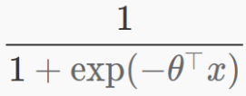
We would arrive at the Logistic Regression equation by the end of this video...
Giving you a glimpse of end result, first:

Slide 4
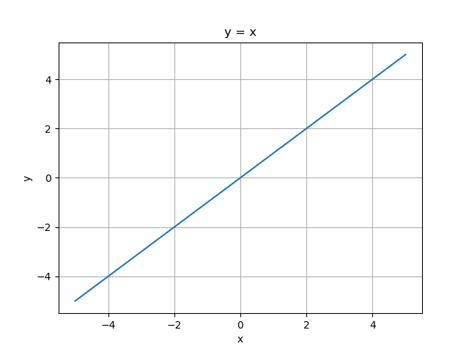
y = x
This is a simple function. Presented here for the completeness of slides.

Slide 5
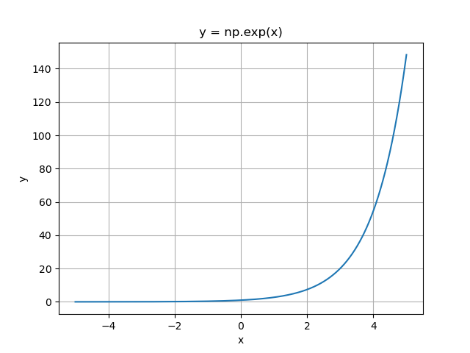
y = np.exp(x)
Note:
np.exp(x) is equal to e^x or math.e**x in Python.
This is monotonically increasing function.
Next, we change it to 1 / (e^x) or equivalently to e^(-x).

Slide 6
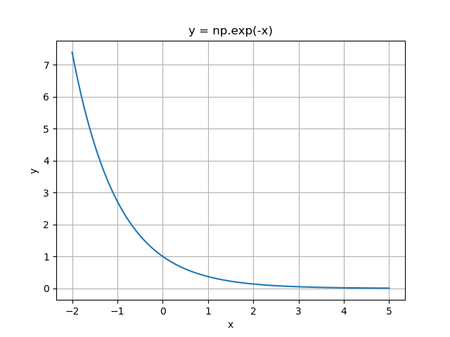
y = np.exp(-x)
np.exp(-x) ==> e^-x ==> 1/(e^x)
Note two things about it:
1: It is monotonically decreasing.
2: The minimum value it takes is 0.
So next, we would shift it by 1.

Slide 7

y = 1 + np.exp(-x)
This is just np.exp(-x) shifted by 1.
Note two things about it:
1: It is also monotonically decreasing.
2: The minimum value it takes is 1.
So next, we would move it to denominator.

Slide 8
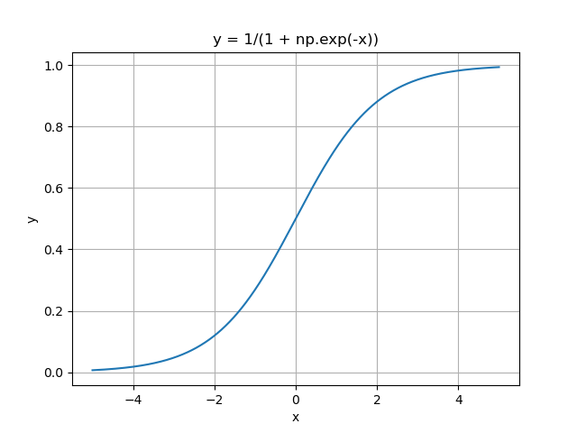
y = 1/(1 + np.exp(-x))

Slide 9
Properties of y = 1/(1 + np.exp(-x))
y = 1/(1 + np.exp(-x))
Implies: y = 1/(1 + 1/e^x)
1. It is a continuous function.
2. It is differentiable everywhere.
Derivative of sigmoid (σ) is: σ(x)(1−σ(x))
3. max(y) = 1
4. min(y) = 0
5. It is rotationally symmetric
around it’s midpoint at (0, 0.5).
What it means in plain English is:
1. Sigmoid has well-defined output range,
2. Easy to optimize, and
3. Has a clear probabilistic interpretation.

Slide 10
What’s with the theta-transpose expression?
Note: “Theta-transpose x” means nothing but dot product of two column (or row) vectors:
Vector 1 → θ: [θ1, θ2,…, θn]
Vector 2 → x: [x1, x2,…, xn]
Then “Theta-transpose x” means: θ1*x1 + θ2*x2 + … + θn*xn

Slide 11
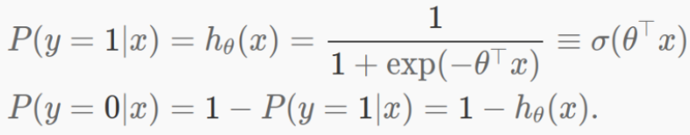
Interpretation
What this means is:
If value from logistic function > 0.5: Class of input is 1
If value from logistic function < 0.5: Class of input is 0

Slide 12
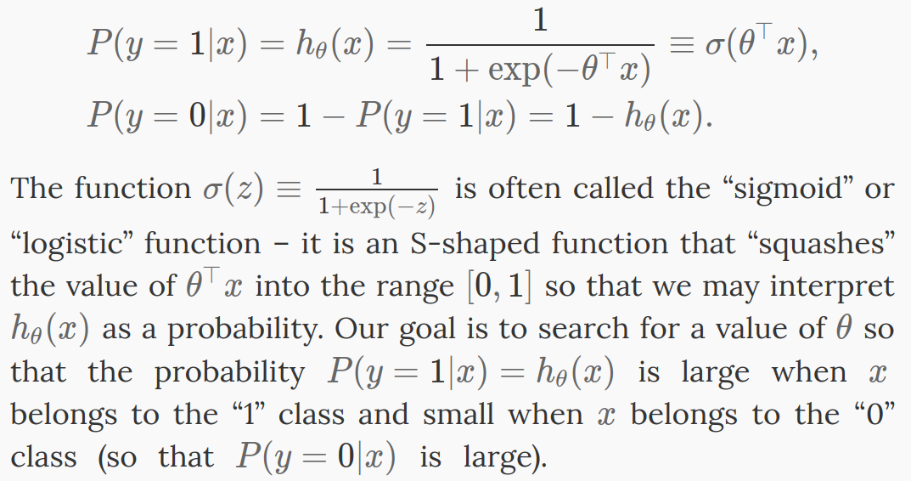
http://ufldl.stanford.edu/tutorial/supervised/LogisticRegression/

Slide 13
References
http://ufldl.stanford.edu/tutorial/supervised/LogisticRegression/
https://www.geeksforgeeks.org/derivative-of-the-sigmoid-function/

